Slide 1

ERG3010 PROJEKT
118010220 HAOTIAN MA (马浩天)
118010224 YU MAO (毛宇)
118010335 Wei WU (吴畏)
118010416 SHIQI Zhang (张诗琪)

Slide 2
CONTENT
1. Project Background
4. Performance Evaluation
3. Further Work
2. Objectives
5. Work Assignments and Contribution

Slide 3

1. Project Background
Goal of the project
Database and working environment of the project

Slide 4
1. Project Background
1.1 Goal of the project
The project aims to study the recorded data of the Structure Inventory and Appraisal of the US Bridges and tries to find out some interesting hidden information from the data.

Slide 5
1. Project Background
1.2 Working Environment:
DB system:
MySQL 8.0 + MySQL Workbench 8.0
2) Website
The website requires python environment:
Python >= 3.7
flask 1.1.2
pymysql 0.9.3

Slide 6
2. Objectives
Database design
Question 1 & 2
Further questions

Slide 7
2.1 Database design

Slide 8
2.1 Database Design
The program mainly divided the raw data into two tables:
“bridge_structure”: the information about the bridges’ structure
“bridge_condtion”: the information about the bridges’ conditions
which were connected with a bridge table: “record_type”

Slide 9
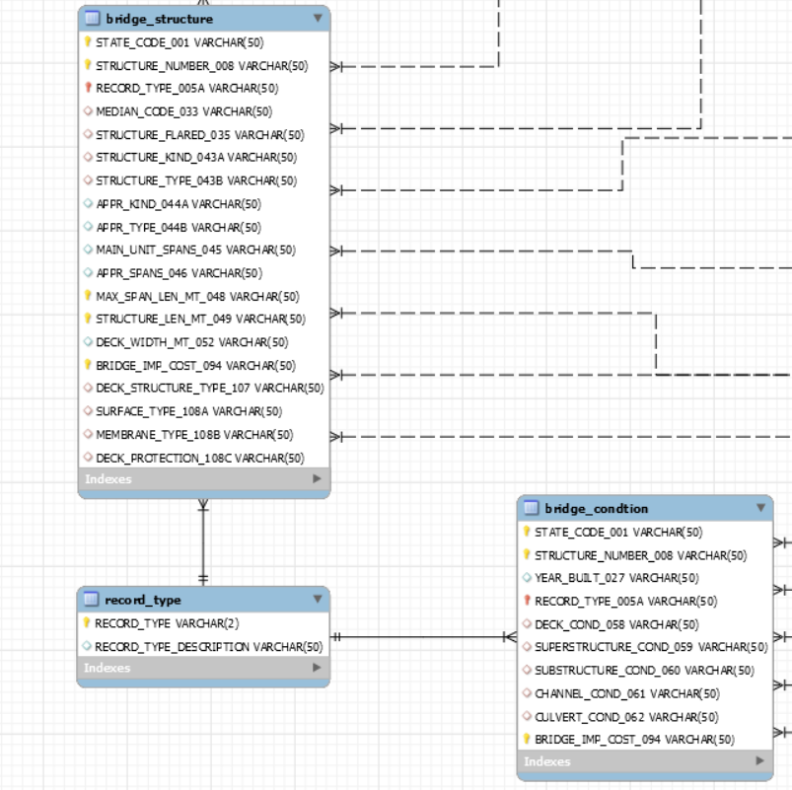
2.1 Database Design
“bridge_structure”
“bridge_condtion”
“record_type”

Slide 10
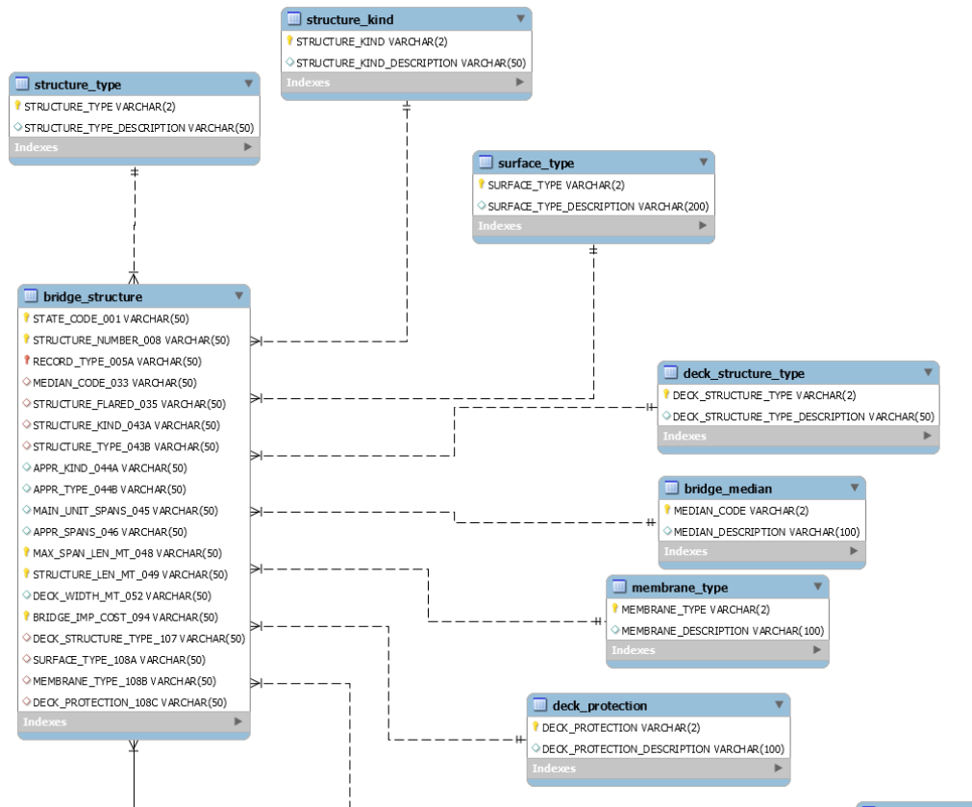
2.1 Database Design
The descriptions of the attributes in these two main tables are built as small tables attached to them
(like “structure_type”, “struct_kind”, “surface_type”)

Slide 11
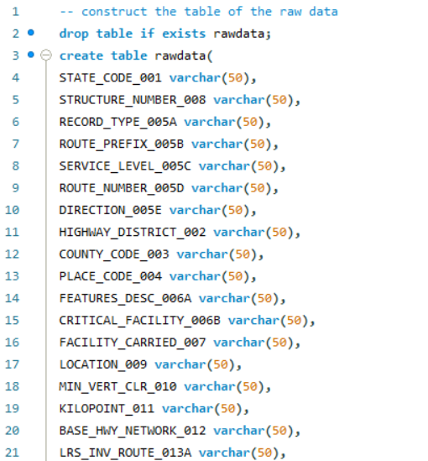
2.1 Database Design
MySQL Code:
1. Create a table called “rawdata” to hold the information of the raw data in the “rawdata-usbridges-csv-2016-utf8.csv” which is the processed data from the original csv file
Step1_Import.sql

Slide 12
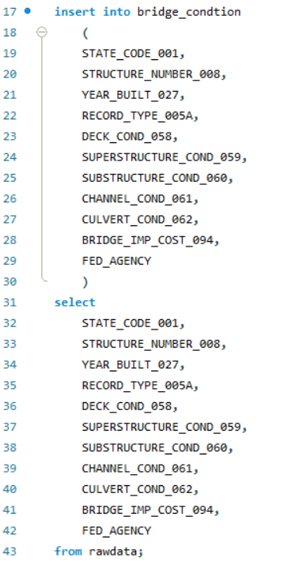
2.1 Database Design
MySQL Code:
2. Construct all the tables of the ERD and import data to them.
Step2_Construction.sql

Slide 13
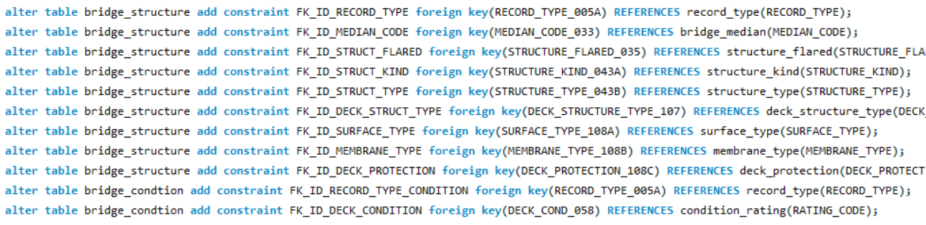
2.1 Database Design
MySQL Code:
Step3_Connection.sql
3. Set primary keys and foreign keys for each table.

Slide 14
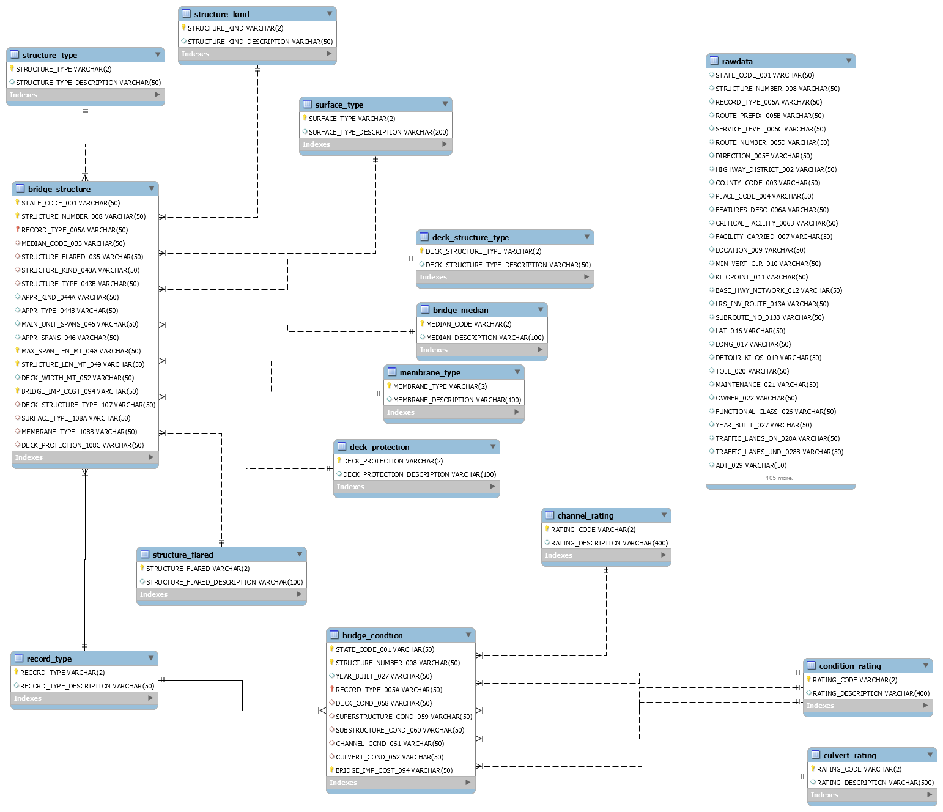
Generate the ERD:

Slide 15
2.2 Question 1

Slide 16
2.2 Question 1： To get the year for every state in US when the largest number of bridges were built in that state.
This part takes out the corresponding table and filters the non-bridge data from the source data with “having record_type_005A=1.”
drop table if exists bridge_count;
create table bridge_count as
select STATE_CODE_001,Structure_number_008,record_type_005A,year_built_027
from rawdata
group by state_code_001,STRUCTURE_NUMBER_008
having count(RECORD_TYPE_005A)=1;
drop table if exists bridge_count1;
create table bridge_count1 as
SELECT STATE_CODE_001 as count_state, year_built_027 as count_year,count(STATE_CODE_001) as count
from bridge_count
group by year_built_027,state_code_001;
select count_state,count_year,max(count) from bridge_count1
group by count_state ;
In this section, we group count the newly created table, find the number of Bridges built in each state per year, and record as count.
In this section, we selected the number of years and data in each state with the most Bridges.

Slide 17
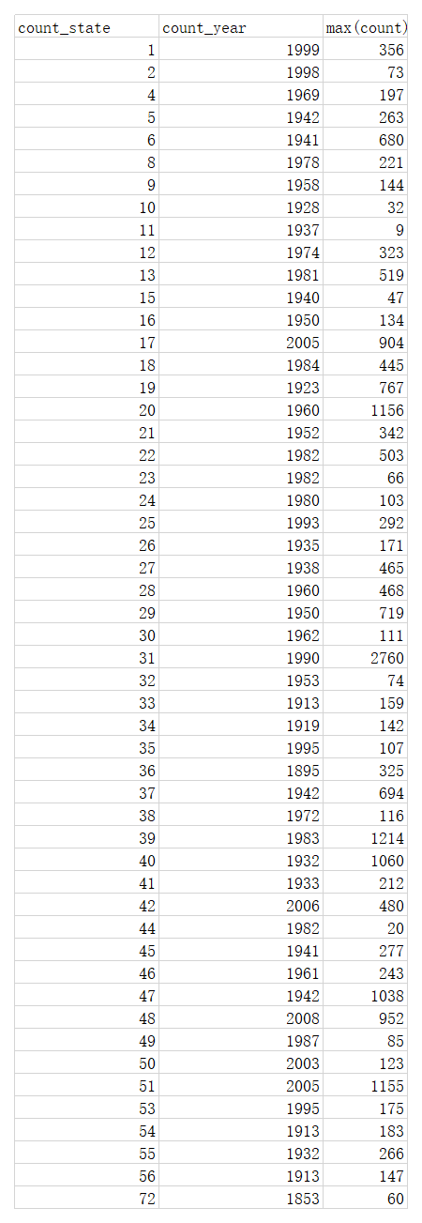
2.2 Question 1 Results

Slide 18
2.3 Question 2

Slide 19
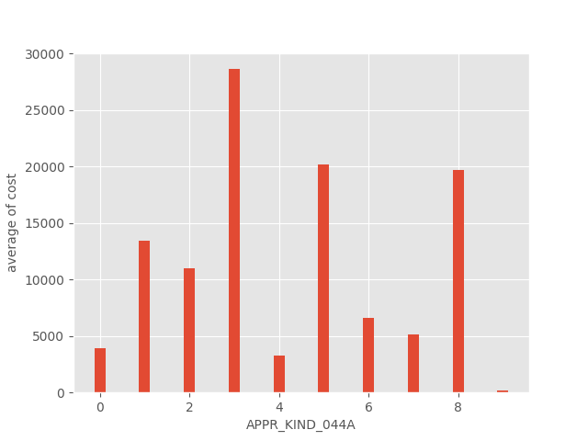
2.3 Question 2

Slide 20
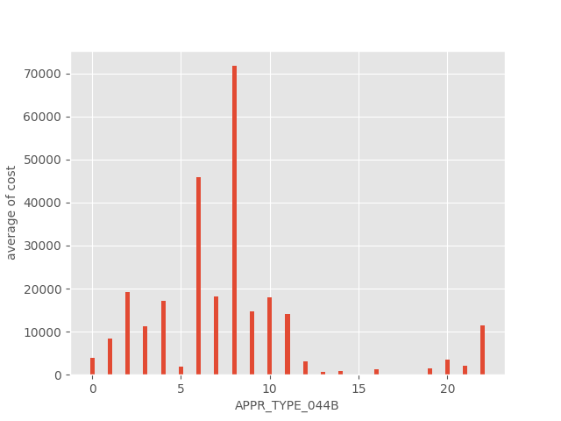
2.3 Question 2

Slide 21
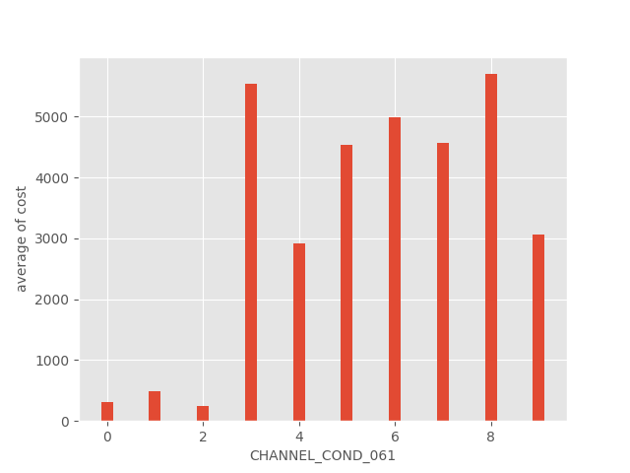
2.3 Question 2

Slide 22
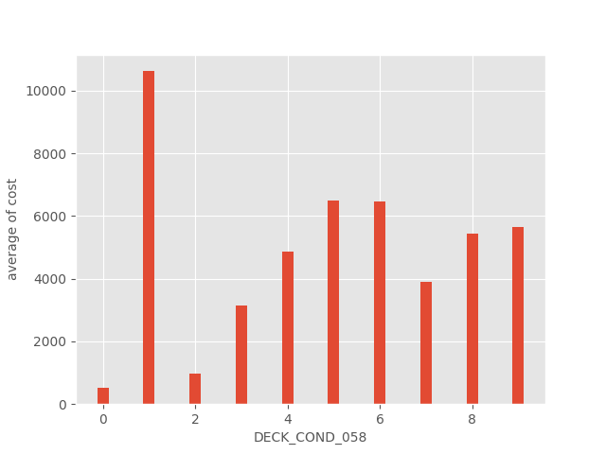
2.3 Question 2

Slide 23
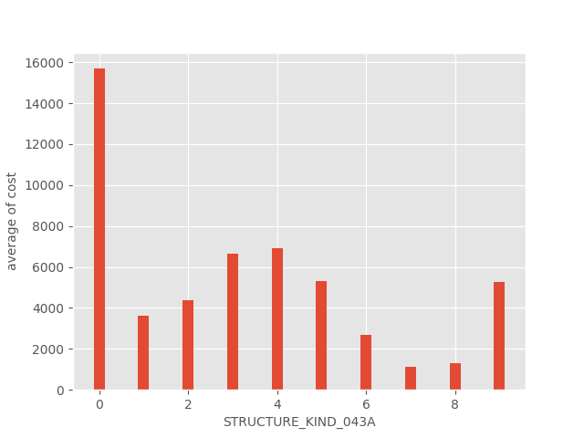
2.3 Question 2

Slide 24
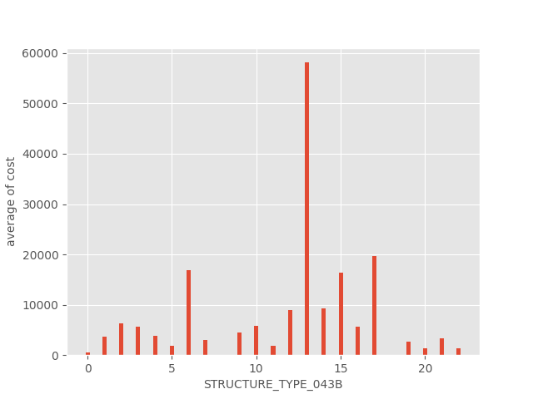
2.3 Question 2

Slide 25
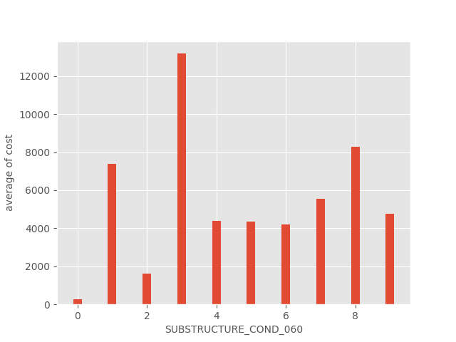
2.3 Question 2

Slide 26
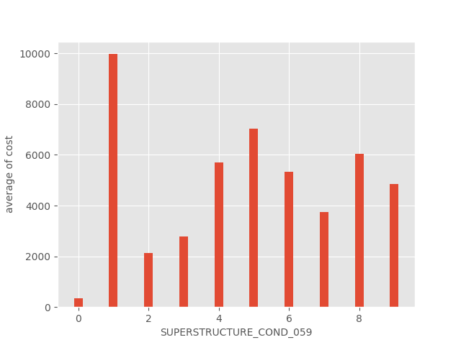
2.3 Question 2

Slide 27
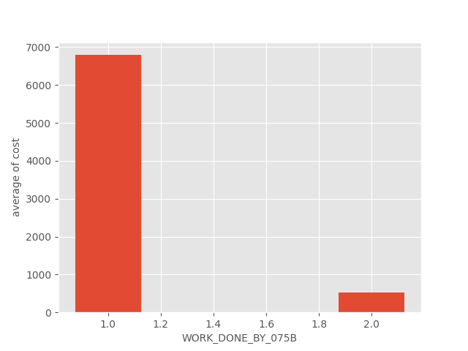
2.3 Question 2

Slide 28
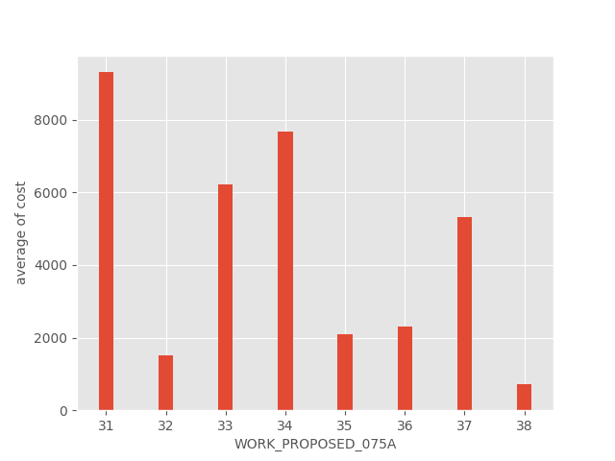
2.3 Question 2

Slide 29

2.4 Further questions
2.4.1 How does design load change over time?
2.4.2 How do structure kind and type change over time?
2.4.3 Is design load correlated with structure type and design type?

Slide 30
2.4.1 How does design load change over time?

Slide 31
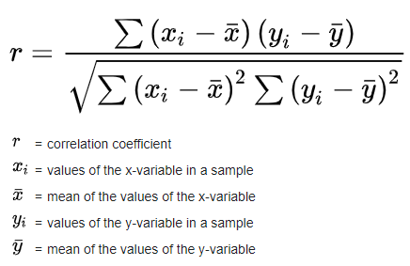
2.4.1 How Does Design Load Change over Time?
Design Load (Metric Unit)
Pearson correlation coefficient
r = 0.86 > 0.75
very good correlation
Year

Slide 32
2.4.2 How Does Structure Kind Change over Time?

Slide 33
2.4.2 How Does Structure Kind Change over Time?
Design Load (Metric Unit)
Structure Kind Ratio
0 | Other
1 | Concrete
2 | Concrete continuous
3 | Steel
4 | Steel continuous
5 | Prestressed concrete
6 | Prestressed concrete continuous
7 | Wood or Timber
8 | Masonry
9 | Aluminum, Wrought Iron, or Cast Iron
Year

Slide 34
2.4.2 How Does Structure Type Change over Time?
Structure Type Ratio
Design Load (Metric Unit)
0 | Other
1 | Slab
2 | Stringer/Multi-beam or Girder
3 | Girder and Floorbeam System
4 | Tee Beam
5 | Box Beam or Girders - Multiple
6 | Box Beam or Girders - Single or Spread
7 | Frame (except frame culverts)
8 | Orthotropic
9 | Truss - Deck
10 | Truss - Thru
11 | Arch - Deck
12 | Arch - Thru
13 | Suspension
14 | Stayed Girder
15 | Movable - Lift
16 | Movable - Bascule
17 | Movable - Swing
18 | Tunnel
19 | Culvert (includes frame culverts)
20 | Mixed types
21 | Segmental Box Girder
22 | Channel Beam
Year

Slide 35
2.4.3 Is design load correlated with structure type and design type?

Slide 36
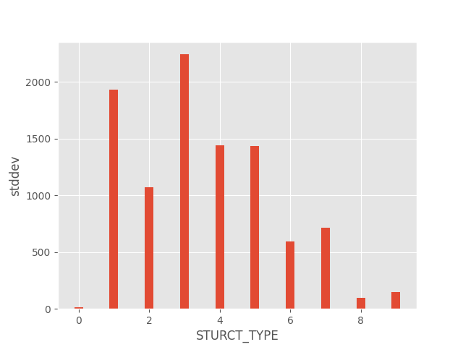
2.4.3.a design load vs structure type

Slide 37
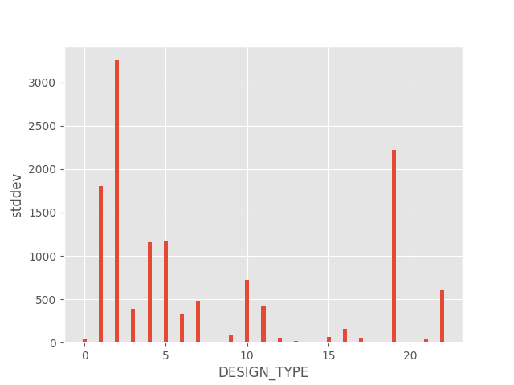
2.4.3.b design load vs design type

Slide 38
3. Further work
Website

Slide 39

3. Website
pymysql
Flask
local mysql database

Slide 40
3. Website
How to run the website:
open the terminal in the folder of the website
type “python app.py” to run the program
open the link generated in the terminal by Chrome

Slide 41
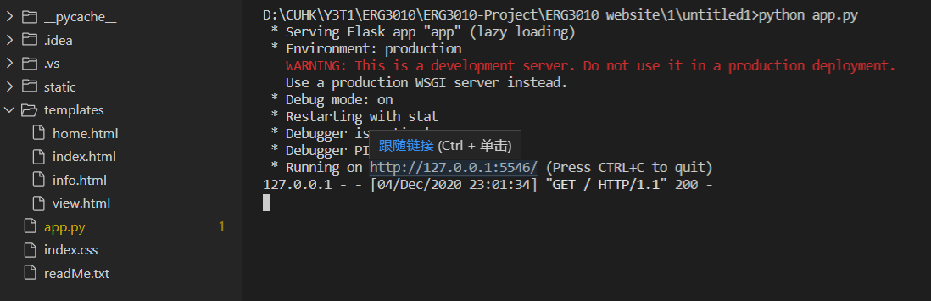

3. Website
1.
2.

Slide 42
3. Website
The search function is connected to the local MySQL database.
And a small table is created for the searching.

Slide 43
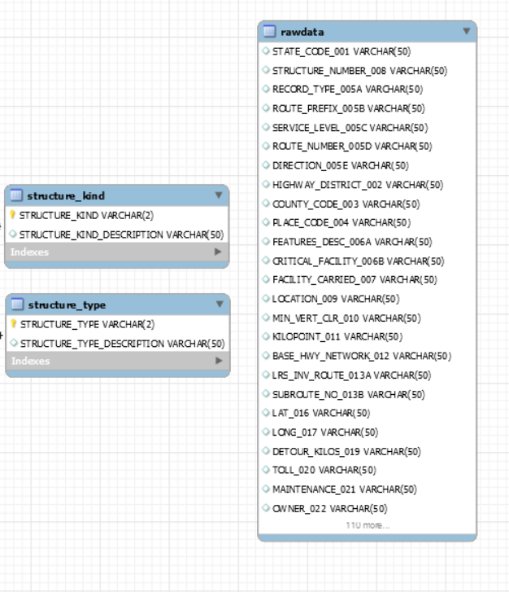
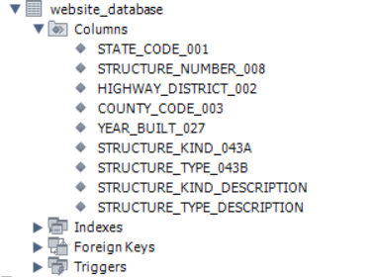
3. Website
a small table is created for the searching

Slide 44
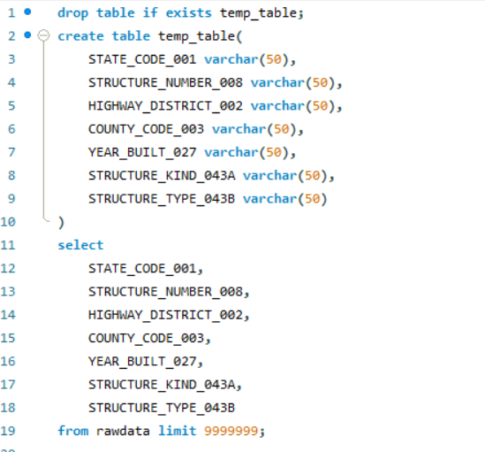
3. Website
create intermediate table_1
holding the attributes in “rawdata”
Step8_Website_database.sql

Slide 45
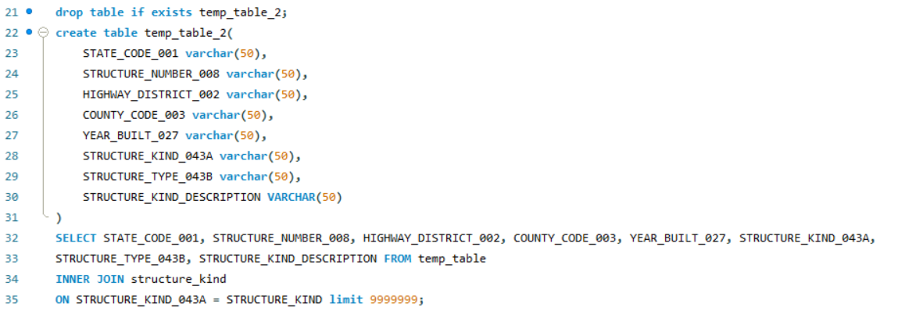
3. Website
Inner join & create intermediate table_2
holding the attributes in
1.“rawdata”
2.“structure_kind”
Step8_Website_database.sql

Slide 46
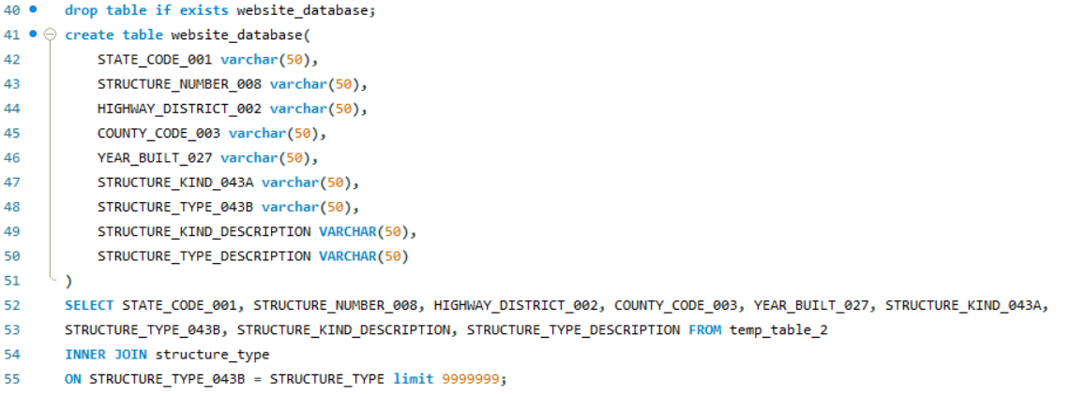
3. Website
Inner join & create target table webstite_database
holding the attributes in
1.“rawdata”
2.“structure_kind”
3.“structure_type”
Step8_Website_database.sql

Slide 47
4. Performance evaluation
Creating Indexes and small tables
PCC Algorithm

Slide 48
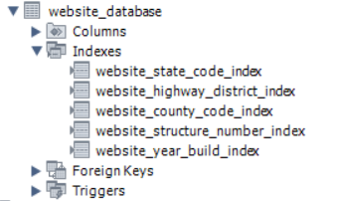
4.1 Creating Indexes and small tables
To improve the searching speed of the website:
a small table “website_database” is created.
some indexes are added to this table.

Slide 49


4.1 Creating Indexes and small tables
Searching speed test: (test in MySQL)
Test script:
Result:

Slide 50
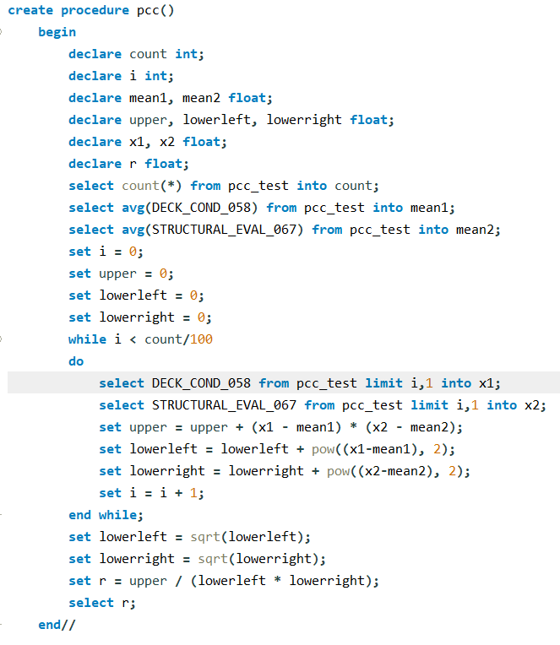
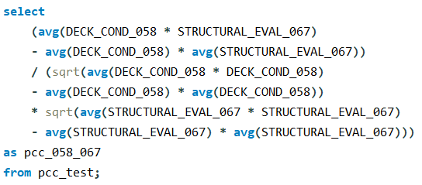
4.2 PCC Algorithm
PCC Algorithm Using Loop
PCC Algorithm Without Loop

Slide 51
4.2 PCC Algorithm

Slide 52

4.2 PCC Algorithm
PCC Algorithm Using Loop
Result (for 1% of the data)

Slide 53

4.2 PCC Algorithm
PCC Algorithm Without Loop
Result (for all of the data)

Slide 54
5. Work assignments & distribution

Slide 55
References
Pictures:
ArtStation - Battlefield V: Rotterdam, Darko Pracic | Battlefield, Rotterdam, Terrain. Retrieved from https://www.google.com.hk/url?sa=i&url=https%3A%2F%2Fwww.pinterest.com%2Fpin%2F381046818470004498%2F&psig=AOvVaw3t9oF_-TVJCYbPW0Zg8JXd&ust=1607241921651000&source=images&cd=vfe&ved=0CA0QjhxqFwoTCKD6j--wtu0CFQAAAAAdAAAAABAD

